Slide 1

Department of Computer Science
University Institute of Engineering
DEPARTMENT OF COMPUTER SCIENCE & ENGINEERING
Bachelor of Engineering
Subject Name: System Programming
Subject Code: CST-315
Compilers
DISCOVER . LEARN . EMPOWER

Slide 2
Chapter 7
Introduction to Linkers and Loaders

Slide 3
Chapter 7 Introduction to Linkers and Loaders
Department of computer Science
LOADERS & LINKAGE
Relocation and linking concepts
Different Loading Schemes
Compile and Go Loader
General Loader Scheme
Absolute Loader Scheme
Subroutine Linkage
Relocating Loaders
Direct Linking Loaders
Self-relocating programs
Sequential and Direct Loaders
Overlay Structure.

Slide 4
Loader and Linker
Unit-1
A program which accepts object program and prepares them for execution.
The source program is converted to object program by assemblers and compilers.
Adjust all address dependent locations, such as address constants, to correspond to the allocated space
Linking involves resolving of symbolic reference between object modules.
Notes:
The source program is converted to object program by assemblers and compilers.
Adjust all address dependent locations, such as address constants, to correspond to the allocated space
Linking involves resolving of symbolic reference between object modules.

Slide 6
Basic Concept
object code, or an object file, is the representation of code that a compiler or assembler generates by processing a source code file.
A linker is typically used to generate an executable file by linking object files together.
Object files often also contain data for use by the code at runtime, relocation information, program symbols (names of variables and functions) for linking and/or debugging purposes, and other debugging information.

Slide 7
Basic Concept…
In MS-DOS, Windows 95/98 etc object modules have extension .obj and the executable binary programs have .exe extension.
In UNIX, object modules have .o extension and executable programs have no extens

Slide 8
Basic Functions of the Loader
ALLOCATION: Allocates space in memory for the programs( calculation program size)
RELOCATION: Adjustment of addresses of all address sensitive entities .
LINKING: Resolve inter-segment (inter-program) symbolic reference in object program. Linking of object modules with each other.
LOADING: Physically place the machine instructions and data into memory and initiate execution.

Slide 9
Loader
Source Program
Loader
Object program
ready for execution
Assembler
Fig.: Role of loader
Memory

Slide 10
Loader
Loader is utility program which takes object code as input prepares it for execution and loads the executable code into the memory.
Thus loader is actually responsible for initiating the executions process.

Slide 11
Relocation and linking concepts

Slide 12
Linking concepts
User defined function and library funtion
Example-printf() ,scanf()
The linking process makes address of modules known to each other so that transfer of control takes place during execution.
Passing of parameter is handled by the linker.
External variable –defined in one module and used in another module.
Resolving of addresses of symbolic reference is handled by the linker.
Notes:
Any usable program written in any language has to use functions/subroutines.
These functions could be either user defined functions or they can be library functions.
For Example-
Consider a prog. In C lang.Such a prog.may contain calls to functions like printf() and scanf().During prog. Execution the main prog. As well as fun. Must reside in the main memory. In addition,every time a function is called,the control should get transferred to the appropriate function.
The linking process makes address of modules known to each other so that transfer of control takes place during execution.
Passing of parameter is handled by the linker. Parameter can be passed by value or by reference. A value retured by a function must be handled.
Every public variable should have the same address in every module.An external variable can be defined in one module and can be used in another module.The address of an external variable should be same in every module. Resolving of addresses of symbolic reference is handled by the linker.

Slide 13
Linking concepts…
Linker-
1.Handled the passing of parameter
2.Resolving of address of symbolic reference

Slide 14
LINKING
Linking is the process of collecting and combining various pieces of code and data into a single file that can be loaded (copied) into memory and executed.
Linking can be performed at compile time, when the source code is translated into machine code, at load time, when the program is loaded into memory and executed by the loader, and even at run time, by application programs.
On early computer systems, linking was performed manually.
On modern systems, linking is performed automatically by programs called linkers.

Slide 15
LINKING
Linkers play a crucial role in software development because they enable separate compilation.
Instead of organizing a large application as one monolithic source file, we can decompose it into smaller, more manageable modules that can be modified and compiled separately.
When we change one of these modules, we simply recompile it and relink the application, without having to recompile the other files.

Slide 16
LINKING
Linking is usually handled quietly by the linker, and is not an important issue for students who are building small programs in introductory programming classes.
So why bother learning about linking?
Understanding linkers will help you build large programs.
Programmers who build large programs often encounter linker errors caused by missing modules, missing libraries, or incompatible library versions.

Slide 17
LINKING
2 Understanding linkers will help you avoid dangerous programming errors.
Programs that incorrectly define multiple global variables pass through the linker without any warnings in the default case. The resulting programs can exhibit baffling run-time behavior and are extremely difficult to debug
3. Understanding linking will help you understand how language scoping rules are implemented.
For example, what is the difference between global and local variables?
What does it really mean when you define a variable or function with the static attribute?

Slide 18
LINKING
4. Understanding linking will help you understand other important systems concepts. The executable object files produced by linkers play key roles in important systems functions such as loading and running programs, virtual memory, paging, and memory mapping.
5. Understanding linking will enable you to exploit shared libraries. e.g. most Web servers rely on dynamic linking of shared libraries to serve dynamic content

Slide 19
Relocation concepts
It is the process of modifying the addresses used in the address sensitive instructions of a program
So, program Can execute correctly from any designated area of memory.
Ex.:-Program A, call function F1();
Program A and F1() must be linked with each other.
Notes:
It is the process of modifying the addresses used in the address sensitive instructions of a program such that the prog. Can execute correctly from any designated area of memory.
Consider the statement
MOVER AREG,X
This is an address sensitive instructions.
For this instruction to execute correctly , the actual address of x should be put in the instruction.
EX. A prog. Written in c Lang.a prog. Name A calls a function F1. A prog. And Function f1() must be linked with each other. But when in main storage shall we load A and F1()? A possible solution would be to load them according to the addresses assigned when they were translated.

Slide 20
Relocation concepts
Case I: Address assigned to Prog. A and F1 () when they translated to memory
Drawback- a lot of storage area
is wasted
0
100
250
400
500
A
Wasted area
F1
Fig.: General Loading scheme
Notes:
Program modules A and B are loaded in memory after linking. It is ready for execution
Case1:At the time of translation, A has been given storage area from 100 to 250 while F1 occupies area between 400 to 500.If we were to load these prog. At their translated address, a lot of storage lying between them will be wasted.

Slide 21
Relocation concepts…
Case II: These two module cannot co-exist at same storage locations.
Main
Storage
0
150
151
251
A
100
250
A
F1
100
200
F1
Relocated address given by the loader
Translation time address
Fig.: Relocation to avoid address conflict or storage waste
Notes:
At time of translation, both A and F1 may have been translated with the identical start address 100. A go to 100 to 250 and F1() go to 100 to 200.
These two module cannot co-exist at same storage locations.
A loader must relocate A and F1 to avoid address conflict or storage waste. A possible relocation shown in figure.

Slide 22
Relocation concepts…
A loader must relocate A and F1 to avoid address conflict or storage waste.
Relocation refers to adjustment of address field not to movement of a program.

Slide 23
Linker Vs. Loader:
Explore the difference between Linker and Loader
When it comes to the execution of any programs, linker and loader play a very important role.
They are the utility programs that support a program while executing.
The purpose of a linker is to produce executable files whereas the major aim of a loader is to load executable files to the memory.
Let’s find out more differences between linker and loader.
What is a Linker?

Slide 24
Linker Vs. Loader:
What is a Linker?
A linker is an important utility program that takes the object files, produced by the assembler and compiler, and other code to join them into a single executable file.
Linkers are also called as link editors.
There are two types of linkers, Static Linking and dynamic Linking
What is a Loader?
In the world of computer science, a loader is a vital component of an operating system that is accountable for loading programs and libraries. Absolute, Direct Linking, Bootstrap and Relocating are the types of loaders.

Slide 25

Linker Vs. Loader:

Slide 26
Static LINKING

Slide 27
Static LINKING
It is performed during the compilation of source program.
Linking is performed before execution in static linking.
It takes collection of relocatable object file and command-line arguments and generates a fully linked object file that can be loaded and run.
The linker copies all library routines used in the program into executable image. As a result, it requires more memory space.
As it does not require the presence of library on the system when it is run, so it is faster and more portable.
No failure chance and less error chance.

Slide 28
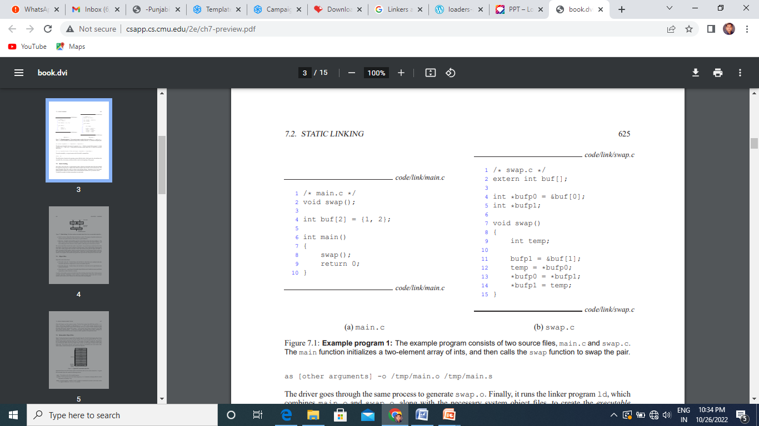
Static LINKING
Example program 1: The example program consists of two source files, main.c and swap.c.
The main function initializes a two-element array of ints, and then calls the swap function to swap the pair.

Slide 29

Static LINKING

Slide 30
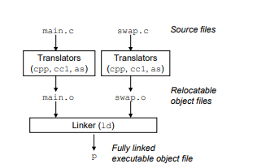
Static LINKING
Figure 7.2: Static linking. The linker combines relocatable object files to form an executable object file p.

Slide 31
Static LINKING
Static linkers such as the Unix ld program take as input a collection of relocatable object files and command line arguments and generate as output a fully linked executable object file that can be loaded and run.
The input relocatable object files consist of various code and data sections.
Instructions are in one section,
initialized global variables are in another section,
and uninitialized variables are in yet another section.

Slide 32
Static LINKING
To build the executable, the linker must perform two main tasks:
Symbol resolution. Object files define and reference symbols. The purpose of symbol resolution is to associate each symbol reference with exactly one symbol definition.
Relocation. Compilers and assemblers generate code and data sections that start at address 0. The linker relocates these sections by associating a memory location with each symbol definition, and then modifying all of the references to those symbols so that they point to this memory location

Slide 33
Dynamic LINKING

Slide 34
Dynamic LINKING
2. Dynamic linking – Dynamic linking is performed during the run time.
This linking is accomplished by placing the name of a shareable library in the executable image.
There are more chances of errors and failures.
It require less memory space as multiple programs can share a single copy of the library.
Here we can perform code sharing. It means if we are using the same object a number of times in the program, instead of linking the same object again and again into the library, each module shares information of the object with other modules having the same object.
The shared library needed in the linking is stored in virtual memory to save RAM.

Slide 35
Object Files
Object files come in three forms:
• Relocatable object file. Contains binary code and data in a form that can be combined with other relocatable object files at compile time to create an executable object file.
• Executable object file. Contains binary code and data in a form that can be copied directly into memory and executed.
• Shared object file. A special type of relocatable object file that can be loaded into memory and linked dynamically, at either load time or run time.
Compilers and assemblers generate relocatable object files (including shared object files).
Linkers generate executable object files.
Linux, later versions of System V Unix, BSD Unix variants, and Sun Solaris — use the Unix Executable and Linkable Format (ELF)

Slide 36
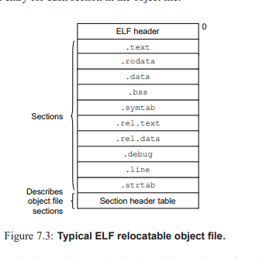
Object Files

Slide 37
Object Files
The ELF header contains information that allows a linker to parse and interpret the object file. This includes
the size of the ELF header,
the object file type (e.g., relocatable, executable, or shared),
the machine type (e.g., IA32)
the size and number of entries in the section header table.
The locations and sizes of the various sections are described by the section header table, which contains a fixed sized entry for each section in the object file.

Slide 38
Object Files
A typical ELF relocatable object file contains the following sections:
.text: The machine code of the compiled program.
.rodata: Read-only data such as the format strings in printf statements
.data: Initialized global C variables. Local C variables are maintained at run time on the stack, and do not appear in either the .data or .bss sections.
.bss: Uninitialized global C variables
.symtab: A symbol table with information about functions and global variables that are defined and referenced in the program.

Slide 39
Symbol Resolution
The linker resolves symbol references by associating each reference with exactly one symbol definition from the symbol tables of its input relocatable object files.
Symbol resolution is straightforward for references to local symbols that are defined in the same module as the reference.
The compiler allows only one definition of each local symbol per module. The compiler also ensures that static local variables, which get local linker symbols, have unique names.
Resolving references to global symbols, however, is trickier. When the compiler encounters a symbol (either a variable or function name) that is not defined in the current module, it assumes that it is defined in some other module, generates a linker symbol table entry, and leaves it for the linker to handle.
If the linker is unable to find a definition for the referenced symbol in any of its input modules, it prints an (often cryptic) error message and terminates.

Slide 40
Symbol Resolution
The linker resolves symbol references by associating each reference with exactly one symbol definition from the symbol tables of its input relocatable object files.
Symbol resolution is straightforward for references to local symbols that are defined in the same module as the reference.
The compiler allows only one definition of each local symbol per module. The compiler also ensures that static local variables, which get local linker symbols, have unique names.
Resolving references to global symbols, however, is trickier. When the compiler encounters a symbol (either a variable or function name) that is not defined in the current module, it assumes that it is defined in some other module, generates a linker symbol table entry, and leaves it for the linker to handle. If the linker is unable to find a definition for the referenced symbol in any of its input modules, it prints an (often cryptic) error message and terminates. For example, if we try to compile and link the following source file on a Linux machine,

Slide 41
Symbol Resolution
then the compiler runs without a hitch, but the linker terminates when it cannot resolve the reference to foo:

Slide 42
Symbol Resolution
How Linkers Resolve Multiply Defined Global Symbols
At compile time, the compiler exports each global symbol to the assembler as either strong or weak,
and the assembler encodes this information implicitly in the symbol table of the relocatable object file.
Functions and initialized global variables get strong symbols.
Uninitialized global variables get weak symbols.

Slide 43
Symbol Resolution
Given this notion of strong and weak symbols, Unix linkers use the following rules for dealing with multiply defined symbols:
• Rule 1: Multiple strong symbols are not allowed.
• Rule 2: Given a strong symbol and multiple weak symbols, choose the strong symbol.
• Rule 3: Given multiple weak symbols, choose any of the weak symbols.

Slide 44
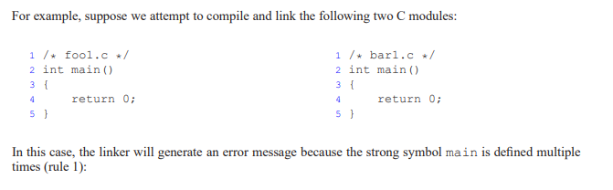
Symbol Resolution
• Rule 1: Multiple strong symbols are not allowed.
• Rule 2: Given a strong symbol and multiple weak symbols, choose the strong symbol.
• Rule 3: Given multiple weak symbols, choose any of the weak symbols.

Slide 45
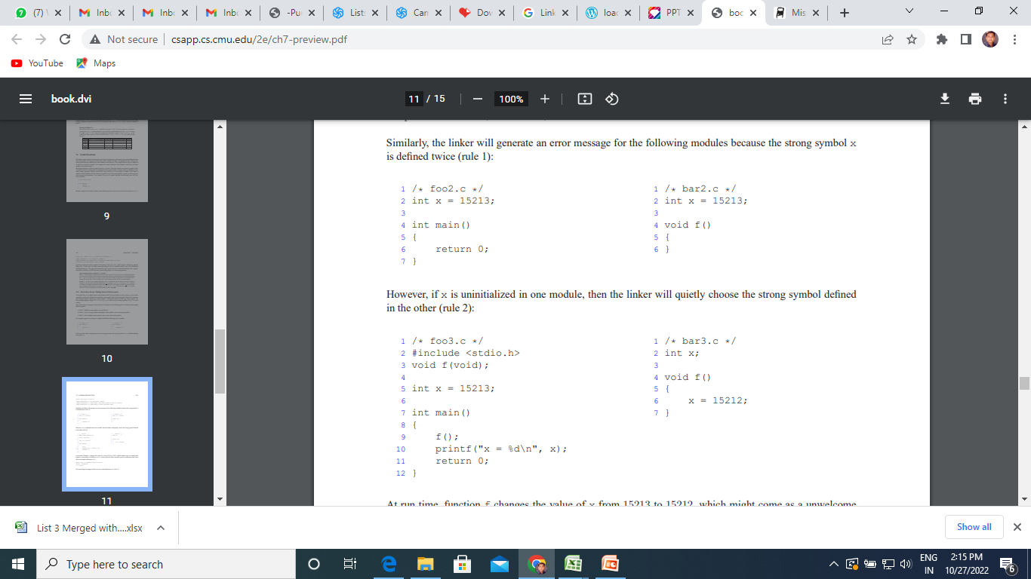
Symbol Resolution
• Rule 1: Multiple strong symbols are not allowed.
• Rule 2: Given a strong symbol and multiple weak symbols, choose the strong symbol.
• Rule 3: Given multiple weak symbols, choose any of the weak symbols.

Slide 46
Symbol Resolution
• Rule 1: Multiple strong symbols are not allowed.
• Rule 2: Given a strong symbol and multiple weak symbols, choose the strong symbol.
• Rule 3: Given multiple weak symbols, choose any of the weak symbols.

Slide 47
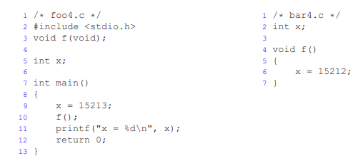
Symbol Resolution
• Rule 3: Given multiple weak symbols, choose any of the weak symbols.

